Slide 1


Ai In Gaming
Supervised By:
Mr. Raviraj Chauhan
Presented by
Dhruv Gandhi - 17SE02CE017
Artificial Intelligence(SECE4042)

Slide 2
Outline
Introduction
Ai Invents New Game
Content Generation For Characters
Creating map and level

Slide 3
Introduction

Slide 4
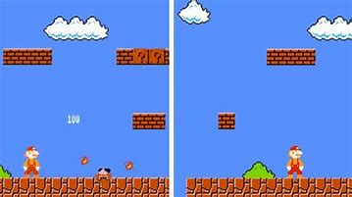
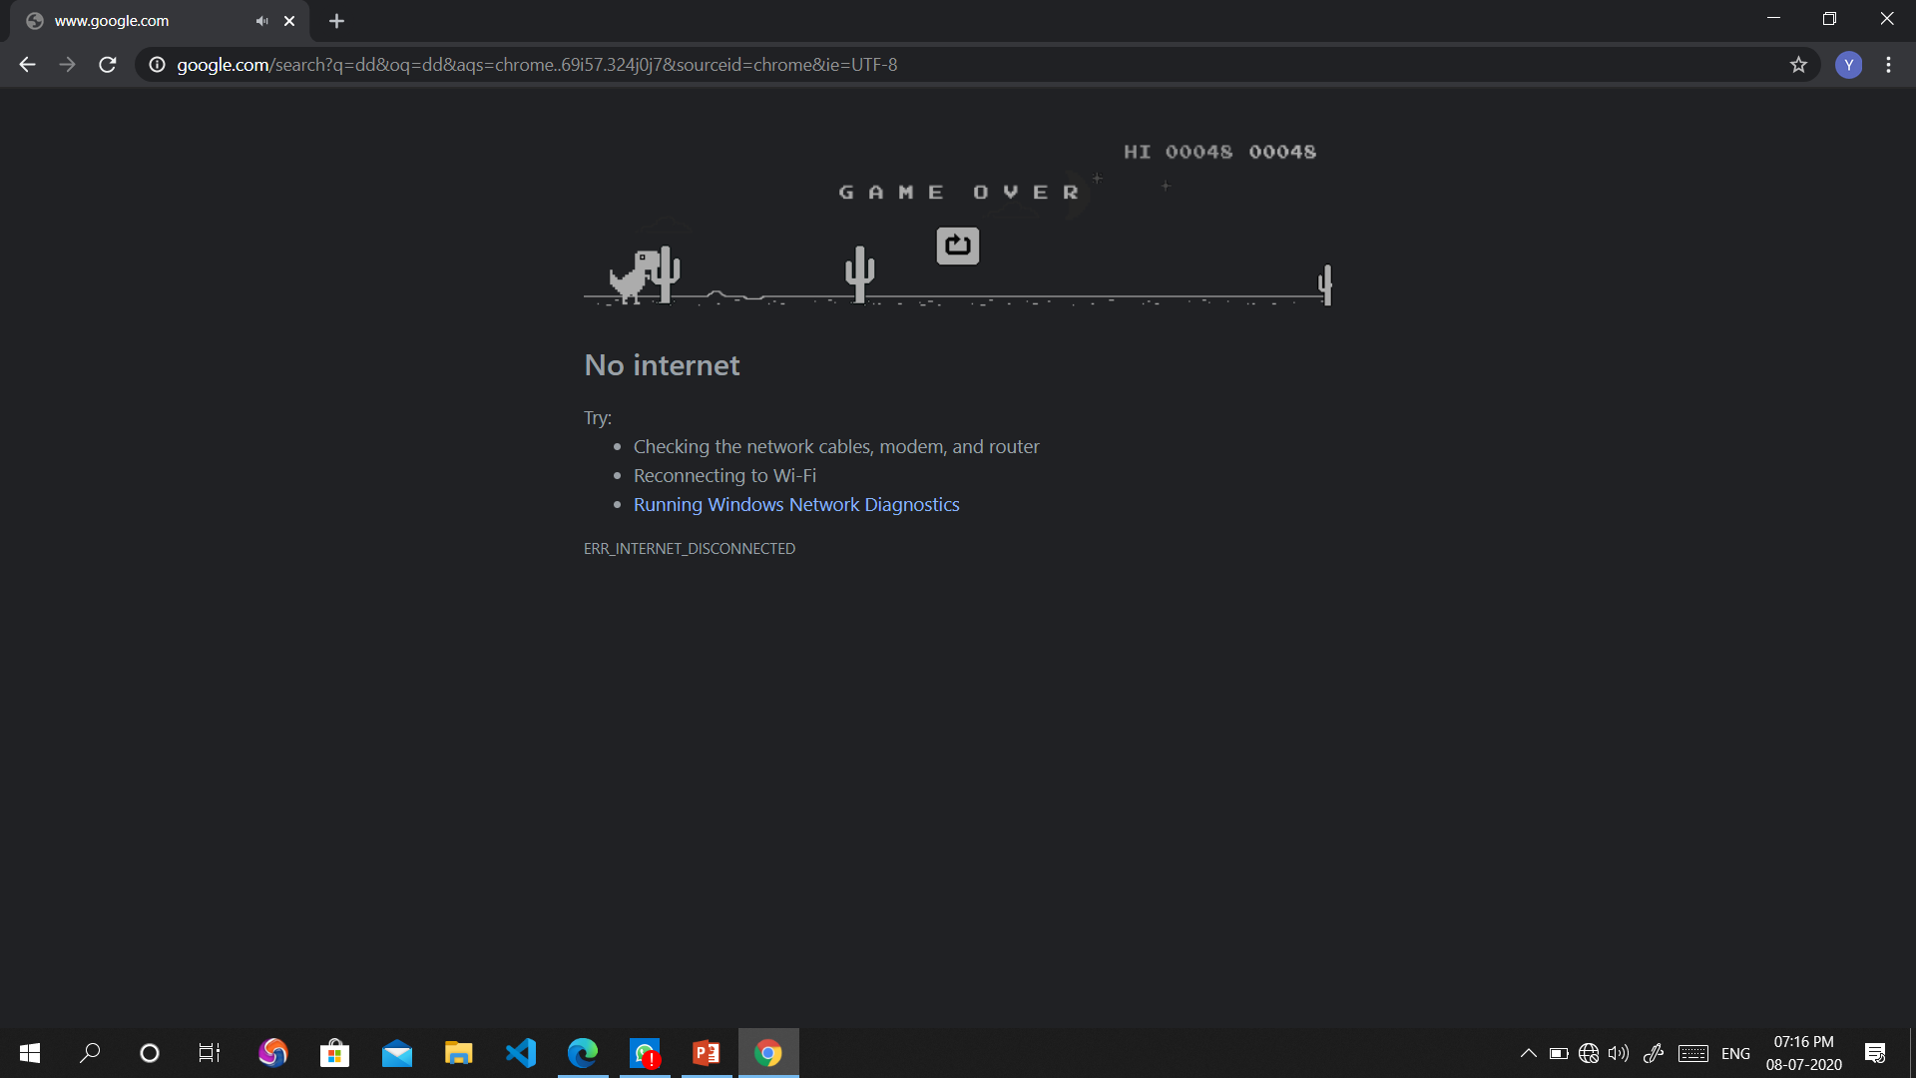
AI Invents New Games

Slide 5

Content Generation For Characters

Slide 6
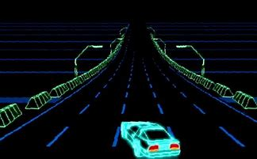
Creating map and Level

Slide 7
Thank You So Much

